Slide 1

Lawson DB2 - IPAHCA – DB2 to BQ Ingestion
December 6th 2024

Slide 2
Today’s agenda
01
Solution
02
Scope
03
Estimates, Pricing & Timelines
04
Q&A

Slide 3
01
Solution

Slide 4
Solution: Historical & Incremental
One Time Historical Adhoc Load
Incremental Loads
Truncate Staging Tables
Refresh Staging Tables in Teradata
Truncate Staging Tables
Refresh Staging Tables in Teradata
Execute Ingestion DAG
Pull all data from DB2 Tables till date and load into BQ Staging Tables
Execute Ingestion DAG
Pull data from DB2 Tables based on incremental time window* and load into BQ Staging Tables
Upsert Core Tables
Execute Converted BQ Merge Scripts & upsert records to core tables
Execute Integration DAG
Execute Converted BQ Merge Scripts & upsert records to core tables
* Time Windows will be decided based on last update timestamp for each table and current timestamp

Slide 5
02
Scope

Slide 6
Inventory Stats
DB Objects | Total
Staging | 31
Core | 31
Audit Tables | 1
Base Views | 31
Curated / Secured Views | 31

Slide 7
Scope & Division of Work
Eviden Responsibilities
Enterprise / Platform Support Responsibilities
Database Object Creations within LOB
Google Secret Manager Key Setup
Variables Configuration in Composer
Data Pipeline Development
Data Validation Setup & Variability Report Generation
QA Testing & Documentation
Alerting for Source Pipeline Kickoff, Completion & Failures
Monitoring & Auditing Data Availability on Dashboards
Operation Guide & Migration Plan Documentation
Code Deployment
Hypercare Support
Query Resolution
Enable GCP access per AAD roles/groups
Git Repository Standup & GIT Secrets Creation
Enable necessary permissions for Github
Firewall access for database-based sources
Create BigQuery Datasets
Service Account access to Services & BigQuery Datasets
Authorization of BQ Datasets
UAT Testing & Signoff
Hypercare Validation
Change Management
Alerting & Monitoring Project enablement

Slide 8
03
Estimates, Pricing & Timelines

Slide 9
Estimates, Pricing & Timelines Table
Build Hours | QA Hours | Hypercare | Total Hours | Resources | Cost
623 | 134 | 40 | 797 | 4 Dev, 1 QA | $25,000
* Estimates have been derived by utilizing the reusable assets & best practices developed in prior implementations
Sprint Range | Week Range | Activity
1 | 1-2 | Provisioning & Access Control Database Object Creations Build & Test Ingestion Pipeline
2 | 3-4 | Build & Test Integration Pipeline Alerting & Monitoring Documentation QA Completion
3 | 5 | Production Code Deployment & Hypercare

Slide 10
Further Questions?

Slide 11
Appendix

Slide 12
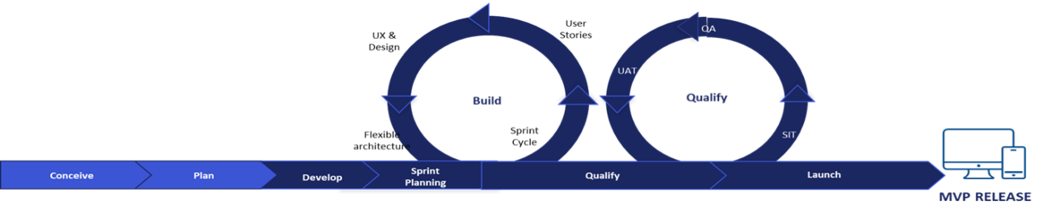
Agile UAT Process
QA and Parallon UAT testing will be performed in the QA environment
UAT planning occurs during the Build phase prior to execution
Request Parallon UAT resources to be available during the entire Test phase of an LOB
Identify a way to automate UAT test cases – welcome to leverage Eviden automated testing scripts
Iteratively complete UAT on a source while Eviden team are QA testing other sources
Manage UAT work iteratively
                Complete all test cases in a sprint
                Test stories to be included on a sprint board
                Attend daily stand-up calls with Eviden
          Complete first round testing of all UAT test cases in first week for a source

Slide 13
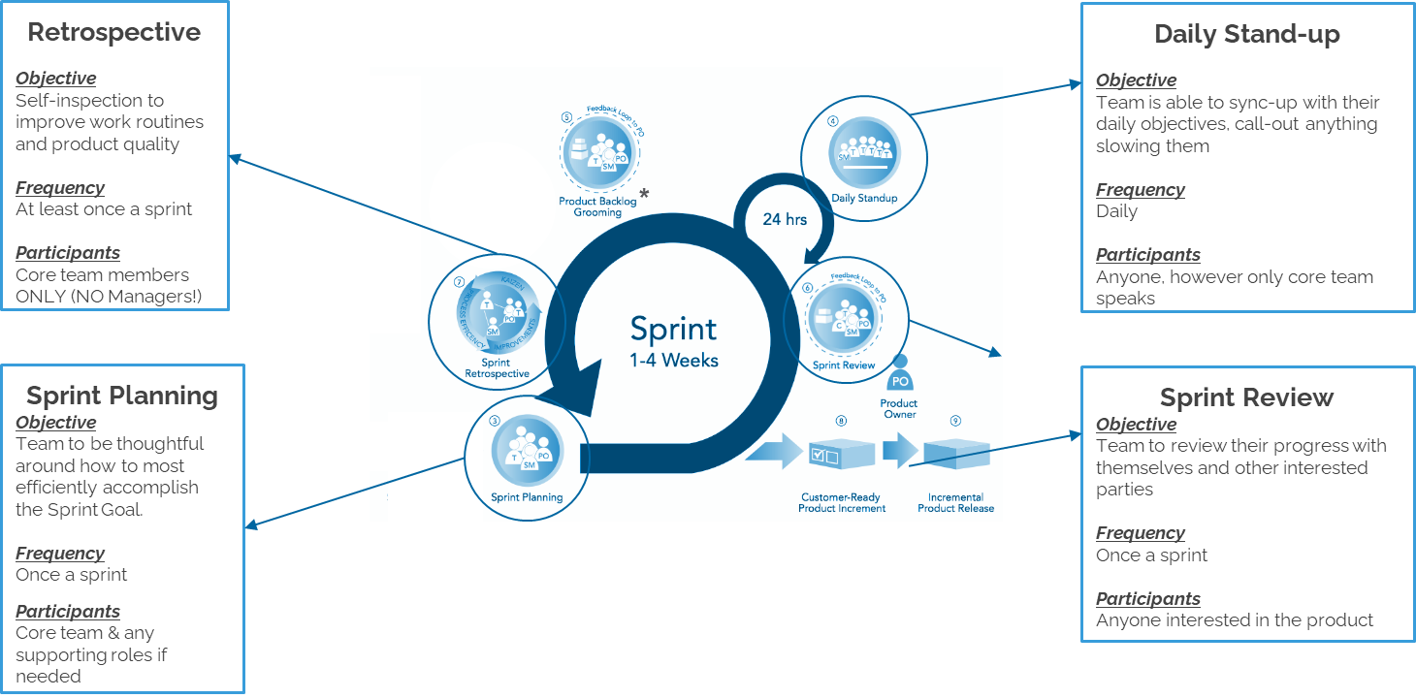
Scrum Agile Framework

